Slide 1
KEB-45250 Numerical Techniques for Process Modeling
Spring 2018
Lecture 3
Introduction to Computational Fluid Dynamics
Antti Mikkonen

Slide 2
Last lecture
Lectures |  | Exercises
Introduction |  | Python basics and libraries
Basics. Matrix, NS,… |  | Lecture topic
CFD Basics |  | Lecture topic
ANSYS intensive course |  | ANSYS intensive course
Heat convection, FVM |  | Lecture topic with Python
Advection |  | Lecture topic with Python
Navier-Stokes |  | Navier-Stokes with ANSYS
Mesh |  | Mesh with ANSYS
Turbulence |  | Turbulence with ANSYS
Differential equations |  | Lecture topic
Linear systems |  | Lecture topic
Easter Holiday |  | Easter Holiday
Linear/Non-linear systems |  | Lecture topic
Non-linear systems |  | Lecture topic
Reacting systems |  | Lecture topic
Reacting systems |  | Lecture topic
Review of relevant subjects
Math
Equation types, matrices
Physics
Advection, Convection, Diffusion, Navier-Stokes
Dimensionless numbers
Chemistry
Arrhenius equation

Slide 3
This lecture
Lectures |  | Exercises
Introduction |  | Python basics and libraries
Basics. Matrix, NS,… |  | Lecture topic
CFD Basics |  | Lecture topic
ANSYS intensive course |  | ANSYS intensive course
Heat convection, FVM |  | Lecture topic with Python
Advection |  | Lecture topic with Python
Navier-Stokes |  | Navier-Stokes with ANSYS
Mesh |  | Mesh with ANSYS
Turbulence |  | Turbulence with ANSYS
Differential equations |  | Lecture topic
Linear systems |  | Lecture topic
Easter Holiday |  | Easter Holiday
Linear/Non-linear systems |  | Lecture topic
Non-linear systems |  | Lecture topic
Reacting systems |  | Lecture topic
Reacting systems |  | Lecture topic
Introduction Computational Fluid Dynamics (CFD)
What is CFD?
Relevant math
Preprocessing

Slide 4
Near future
Lectures |  | Exercises
Introduction |  | Python basics and libraries
Basics. Matrix, NS,… |  | Lecture topic
CFD Basics |  | Lecture topic
ANSYS intensive course |  | ANSYS intensive course
Heat convection, FVM |  | Lecture topic with Python
Advection |  | Lecture topic with Python
Navier-Stokes |  | Navier-Stokes with ANSYS
Mesh |  | Mesh with ANSYS
Turbulence |  | Turbulence with ANSYS
Differential equations |  | Lecture topic
Linear systems |  | Lecture topic
Easter Holiday |  | Easter Holiday
Linear/Non-linear systems |  | Lecture topic
Non-linear systems |  | Lecture topic
Reacting systems |  | Lecture topic
Reacting systems |  | Lecture topic
ANSYS intensive course next week
Tuesday 9-16 SB202
Wednesday 9-15 RG100C
NOTE THE NONSTANDARD DAYS

Slide 5
Computational Fluid Dynamics
Fluid flow calculation is the basis of all CFD simulations
Other physics and chemistry can be included
Navier-Stokes equations govern fluid flow phenomena

Slide 6
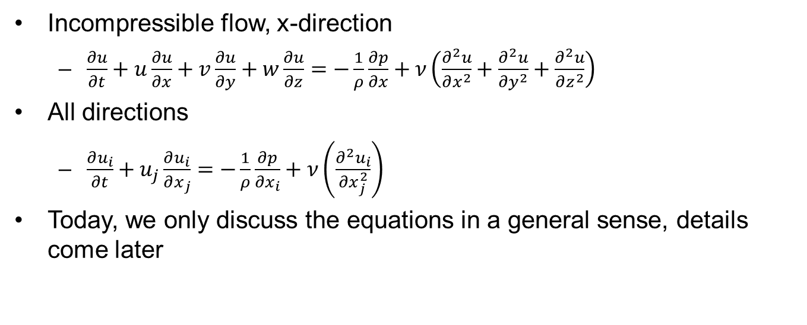
Navier-Stokes
https://www.youtube.com/watch?v=qgKVxOWpi9U
Incompressible flow, x-direction
$\frac{∂u}{∂t}+u\frac{∂u}{∂x}+v\frac{∂u}{∂y}+w\frac{∂u}{∂z}=−\frac{1}{ρ}\frac{∂p}{∂x}+ν\left(\frac{∂^{2}u}{∂x^{2}}+\frac{∂^{2}u}{∂y^{2}}+\frac{∂^{2}u}{∂z^{2}}\right)$
All directions
$\frac{∂u_{i}}{∂t}+u_{j}\frac{∂u_{i}}{∂x_{j}}=−\frac{1}{ρ}\frac{∂p}{∂x_{i}}+ν\left(\frac{∂^{2}u_{i}}{∂x_{j}^{2}}\right)$
Today, we only discuss the equations in a general sense, details come later

Slide 7
Scope of this course
Solution of NS is difficult
We will not program our own NS solver on this course
Unless you want to learn deeper understanding of CFD and program your own solver as the CFD assignment
The case is chosen so that is relatively easy to solve
We will program our own solver for simpler cases (heat conduction etc.)
We will use ANSYS for NS
You still need to understand the basics
You can do the CFD assignment with ANSYS

Slide 8
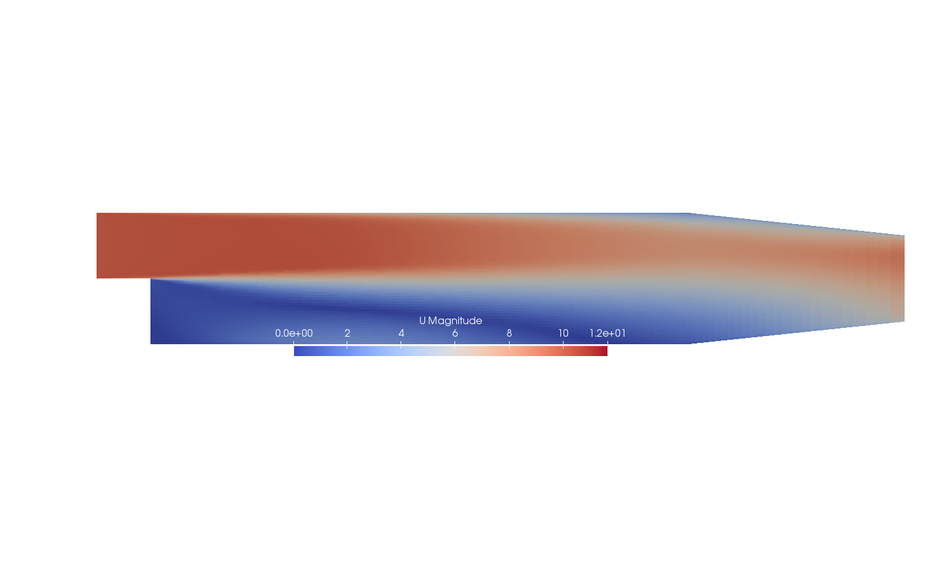
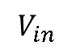
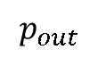
Example case
Classical test case by Pitz and Daily (1981)
$$V_{in}$$
$$p_{out}$$

Slide 9
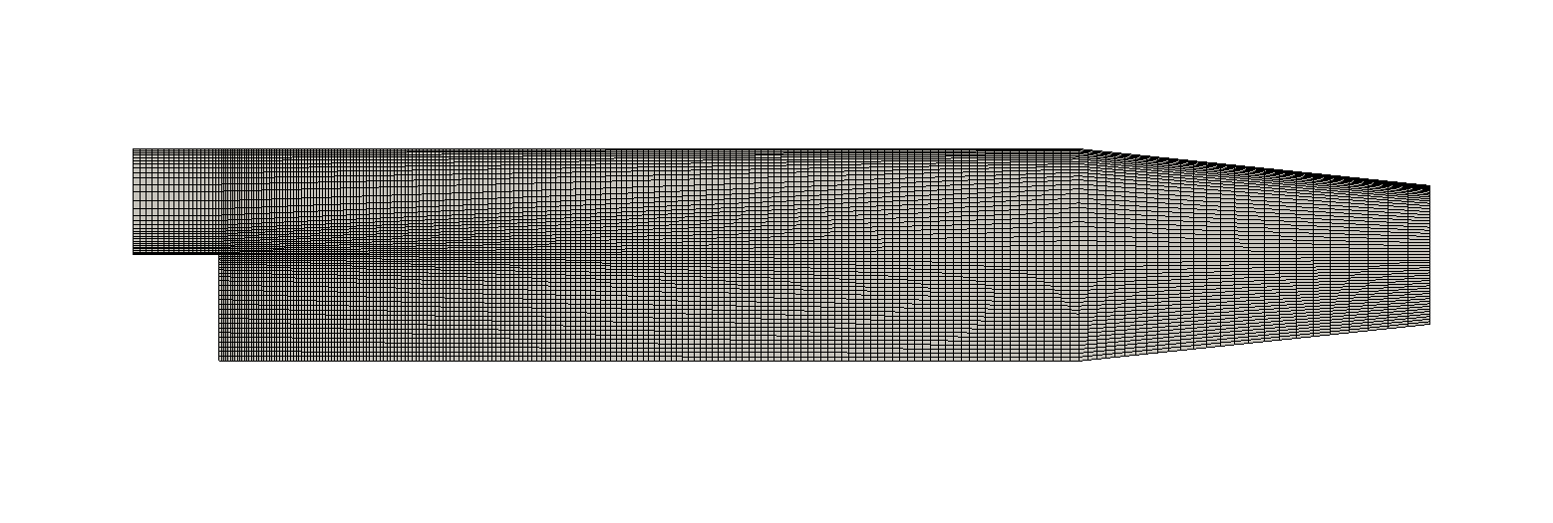
Mesh

Slide 10
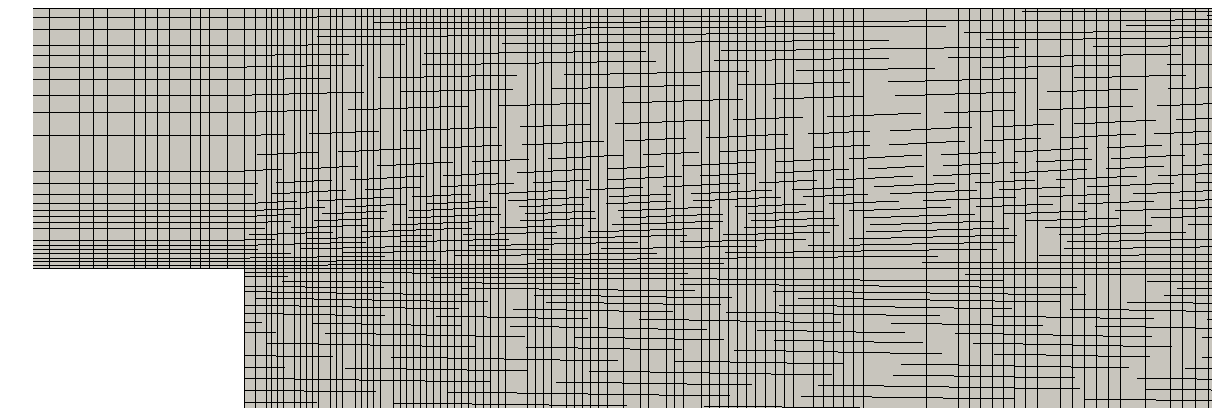
Mesh close up

Slide 11
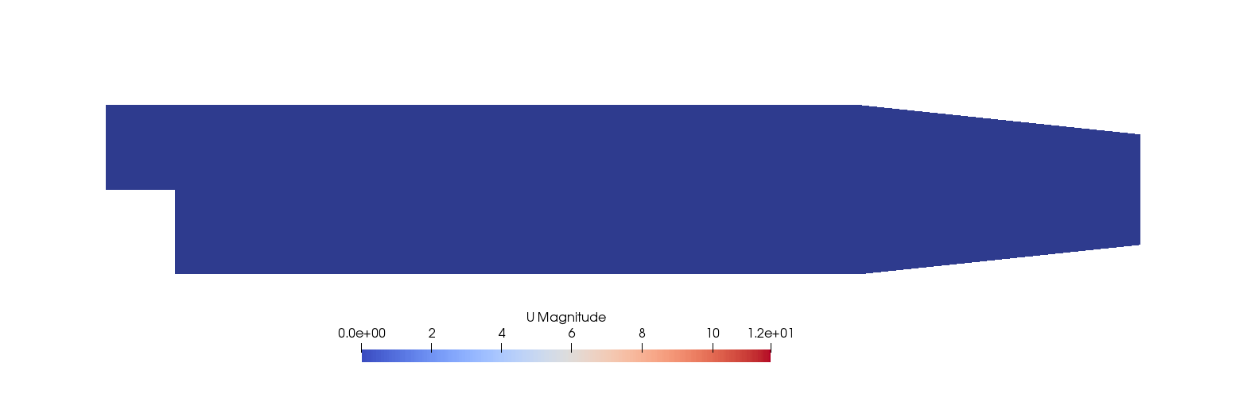
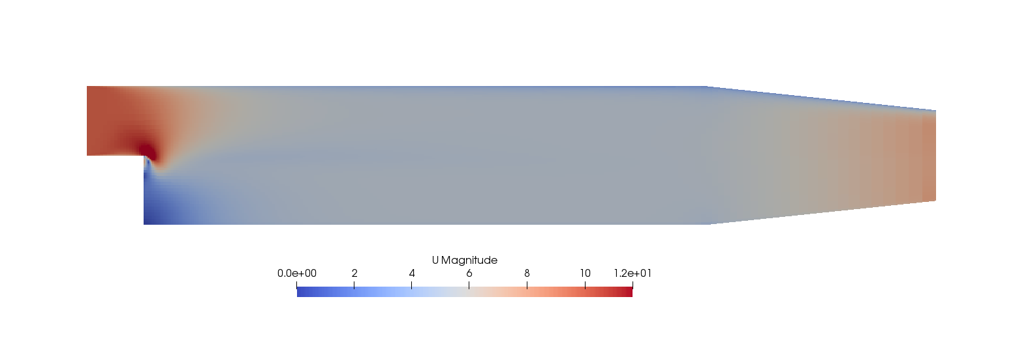
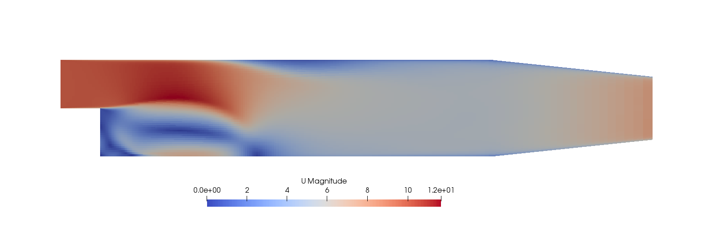
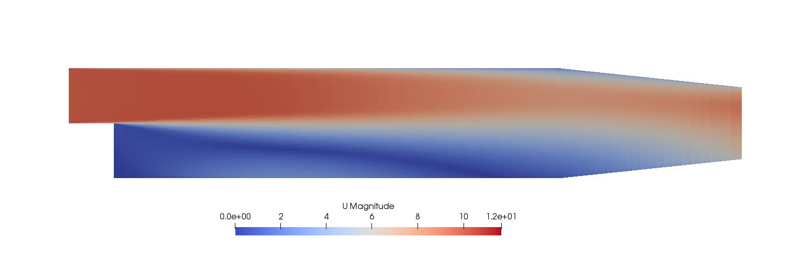
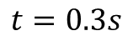
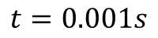
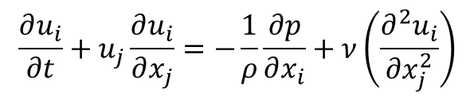
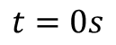
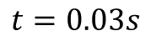
Unsteady
$$\frac{∂u_{i}}{∂t}+u_{j}\frac{∂u_{i}}{∂x_{j}}=−\frac{1}{ρ}\frac{∂p}{∂x_{i}}+ν\left(\frac{∂^{2}u_{i}}{∂x_{j}^{2}}\right)$$
$$t=0s$$
$$t=0.001s$$
$$t=0.03s$$
$$t=0.3s$$

Slide 12
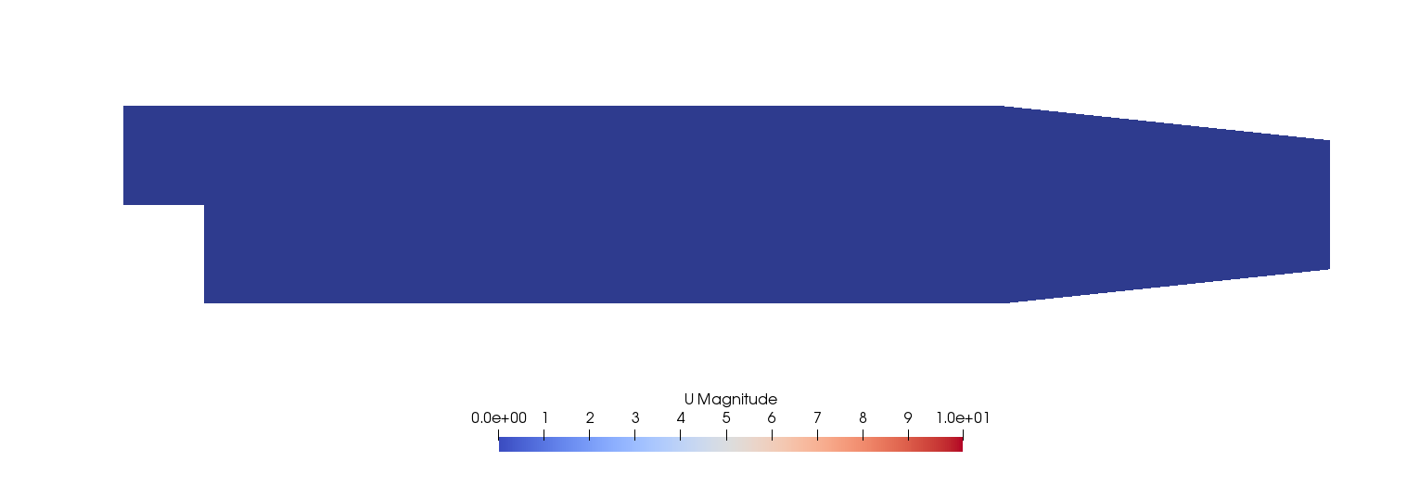
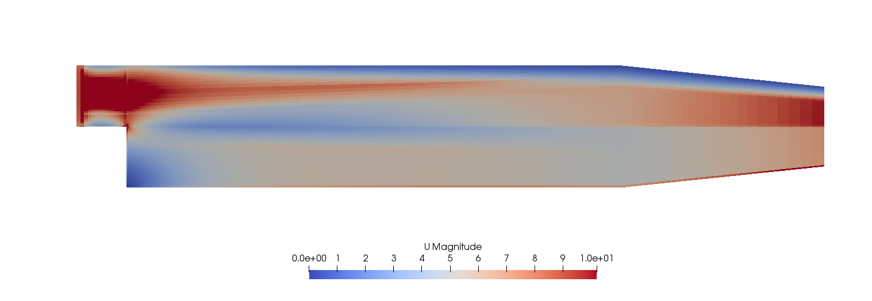
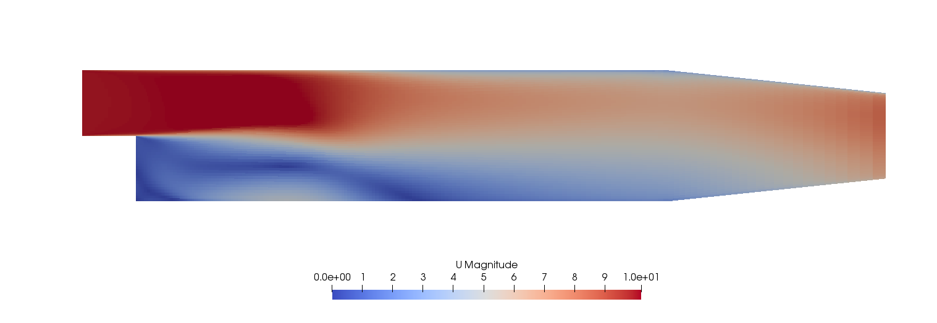
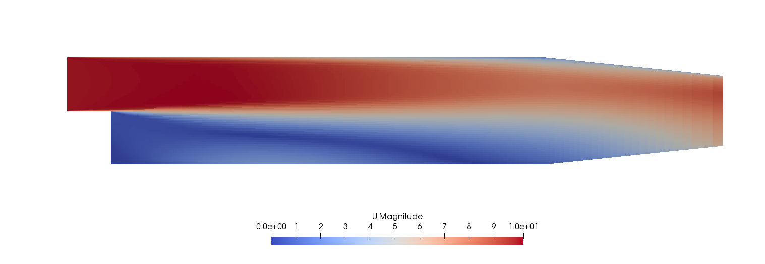
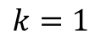
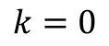
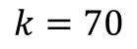
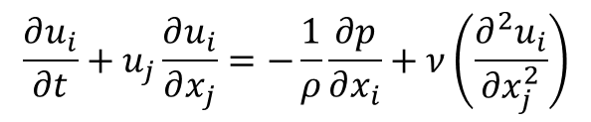
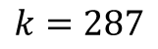
Steady state
0
$$\frac{∂u_{i}}{∂t}+u_{j}\frac{∂u_{i}}{∂x_{j}}=−\frac{1}{ρ}\frac{∂p}{∂x_{i}}+ν\left(\frac{∂^{2}u_{i}}{∂x_{j}^{2}}\right)$$
k is iteration step
$$k=0$$
$$k=1$$
$$k=70$$
$$k=287$$

Slide 13
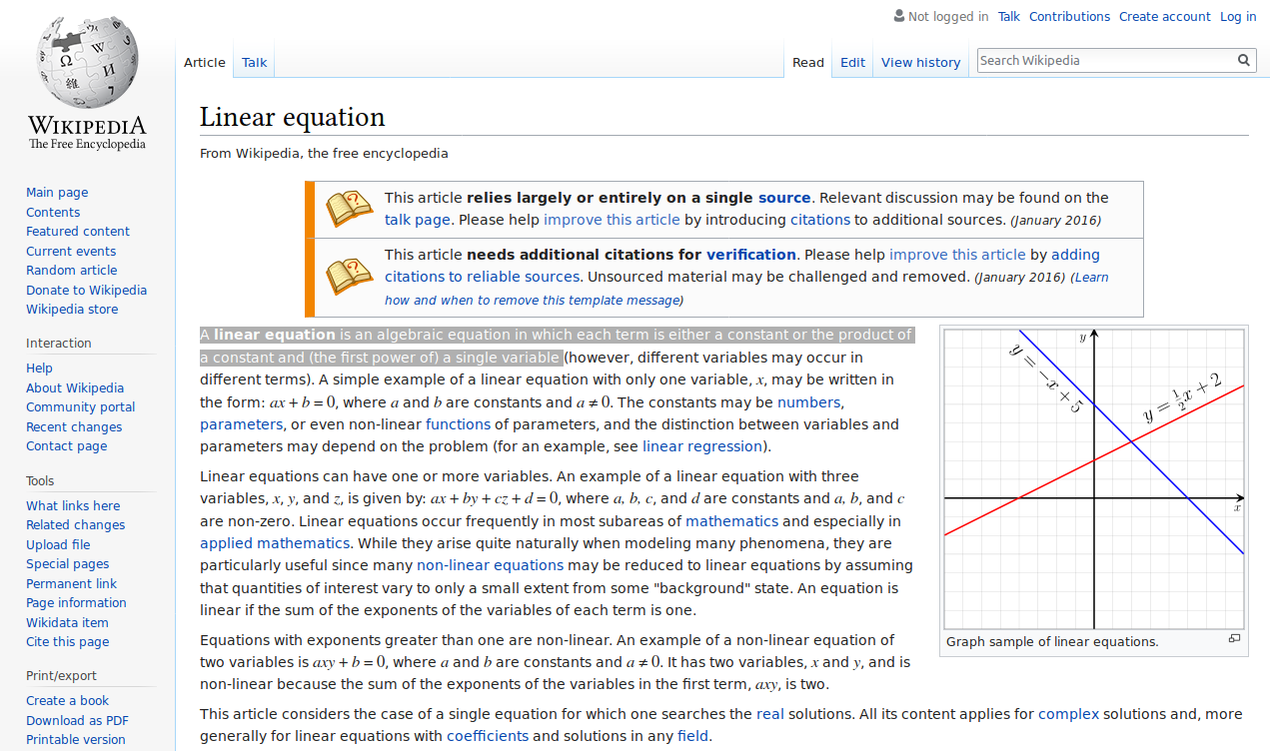

Slide 14
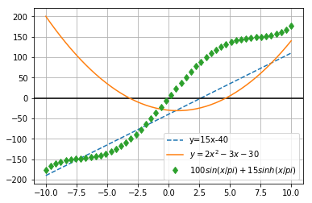
Linear vs. nonlinear
…all else is nonlinear
Nonlinear equations don’t always have analytical solutions
May be difficult to solve numerically
The same ideas can be extended to systems of equations

Slide 15
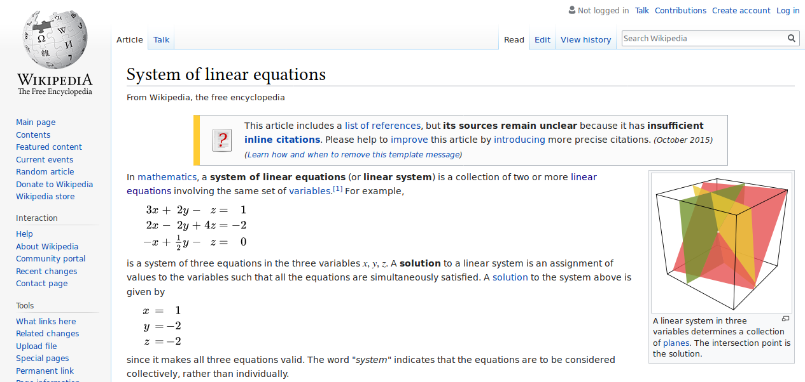
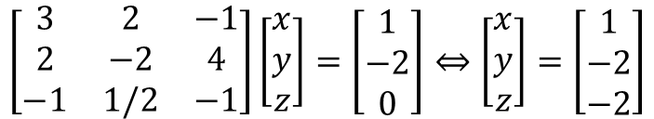
$$\left[\begin{matrix}3 & 2 & −1 \\ 2 & −2 & 4 \\ −1 & 1/2 & −1\end{matrix}\right]\left[\begin{matrix}x \\ y \\ z\end{matrix}\right]=\left[\begin{matrix}1 \\ −2 \\ 0\end{matrix}\right]⇔\left[\begin{matrix}x \\ y \\ z\end{matrix}\right]=\left[\begin{matrix}1 \\ −2 \\ −2\end{matrix}\right]$$

Slide 16
Why are we talking about matrices?
The governing equations of fluid flow can be approximated with systems of algebraic equations
Linear matrix systems are easily solved with computer algorithms
Understanding the methods of how to do this is understanding CFD

Slide 17
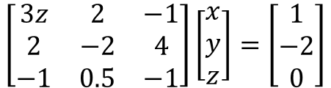

Nonlinear system
$$\text{3}x\text{z}\text{ +2}\text{y}\text{−}\text{z}\text{ =1}$$
$$\text{2}\text{x}\text{−}\text{2}\text{y}\text{−4 =−2}$$
$$\text{−}\text{x}\text{+0.5}\text{y}\text{−}\text{z}\text{ =}\text{0}$$
Or in matrix form
$$\left[\begin{matrix}3z & 2 & −1 \\ 2 & −2 & 4 \\ −1 & 0.5 & −1\end{matrix}\right]\left[\begin{matrix}x \\ y \\ z\end{matrix}\right]=\left[\begin{matrix}1 \\ −2 \\ 0\end{matrix}\right]$$

Slide 18
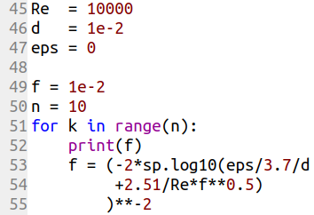
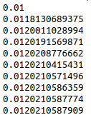
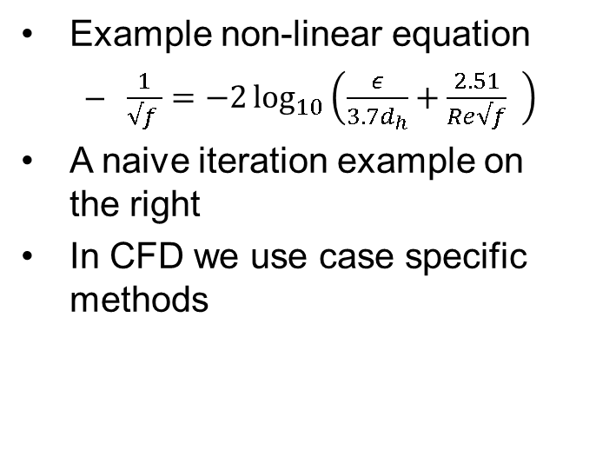
Iterative solution
Example non-linear equation
$\frac{1}{√f }=−2\log_{10}\left(\frac{ε}{3.7d_{h}}+\frac{2.51}{Re√f} \right)$
A naive iteration example on the right
In CFD we use case specific methods
Out:

Slide 19
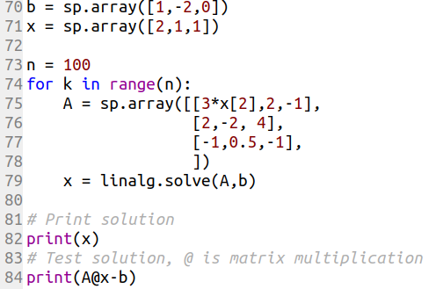
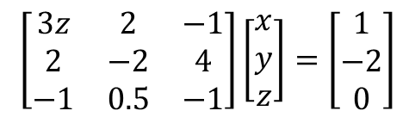
Nonlinear system solution
Naive iteration for matrix system
Gives x = [1 4 1]
Error
Ax-b=[0 0 -2e-16]
$$\left[\begin{matrix}3z & 2 & −1 \\ 2 & −2 & 4 \\ −1 & 0.5 & −1\end{matrix}\right]\left[\begin{matrix}x \\ y \\ z\end{matrix}\right]=\left[\begin{matrix}1 \\ −2 \\ 0\end{matrix}\right]$$

Slide 20
Disclaimer
It might be difficult to find the answer
Better methods for general nonlinear equations can be found from nearly any programming language
The naive method is used here for simplicity
In CFD, case special methods are used

Slide 21
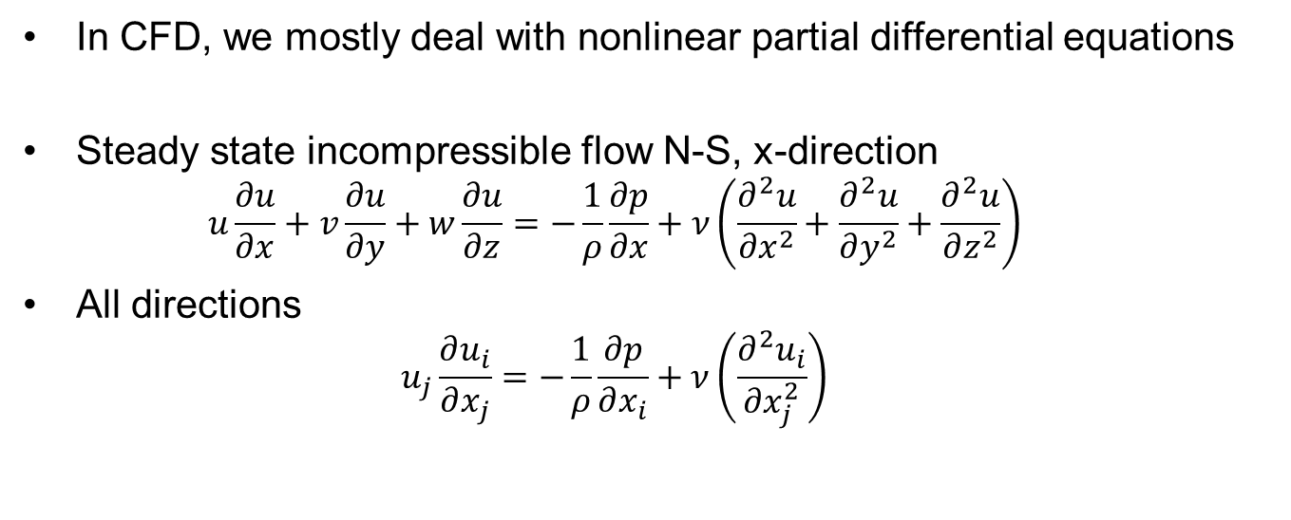
Nonlinear PDE
In CFD, we mostly deal with nonlinear partial differential equations
Steady state incompressible flow N-S, x-direction
$$u\frac{∂u}{∂x}+v\frac{∂u}{∂y}+w\frac{∂u}{∂z}=−\frac{1}{ρ}\frac{∂p}{∂x}+ν\left(\frac{∂^{2}u}{∂x^{2}}+\frac{∂^{2}u}{∂y^{2}}+\frac{∂^{2}u}{∂z^{2}}\right)$$
All directions
$$u_{j}\frac{∂u_{i}}{∂x_{j}}=−\frac{1}{ρ}\frac{∂p}{∂x_{i}}+ν\left(\frac{∂^{2}u_{i}}{∂x_{j}^{2}}\right)$$

Slide 22
Solution strategy
Linearize the PDE
Approximate PDE with a system of algebraic equations
Solve iteratively

Slide 23
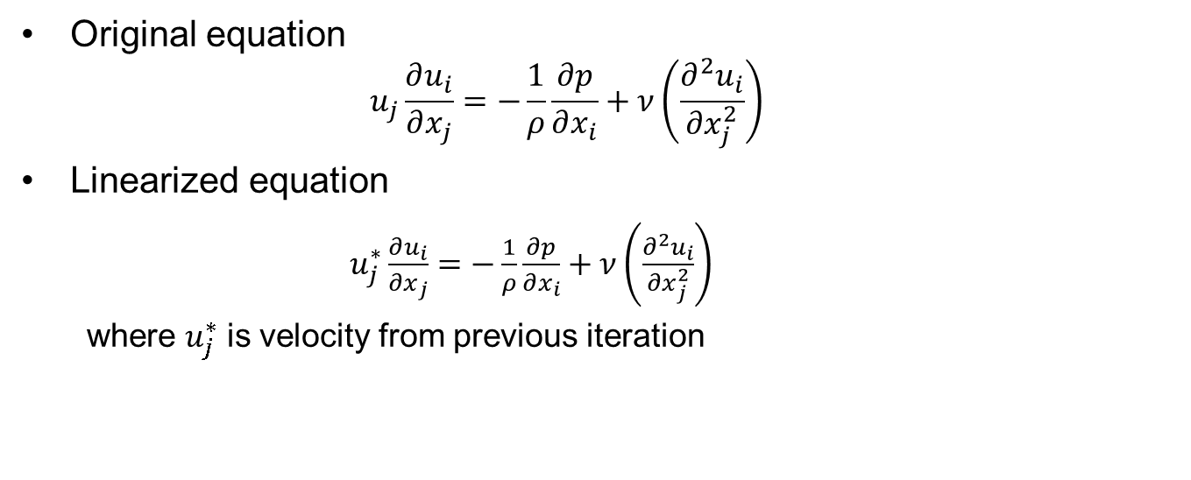
Simple linearization
Original equation
$$u_{j}\frac{∂u_{i}}{∂x_{j}}=−\frac{1}{ρ}\frac{∂p}{∂x_{i}}+ν\left(\frac{∂^{2}u_{i}}{∂x_{j}^{2}}\right)$$
Linearized equation
$u_{j}^{∗}\frac{∂u_{i}}{∂x_{j}}=−\frac{1}{ρ}\frac{∂p}{∂x_{i}}+ν\left(\frac{∂^{2}u_{i}}{∂x_{j}^{2}}\right)$
where $u_{j}^{∗}$ is velocity from previous iteration

Slide 24
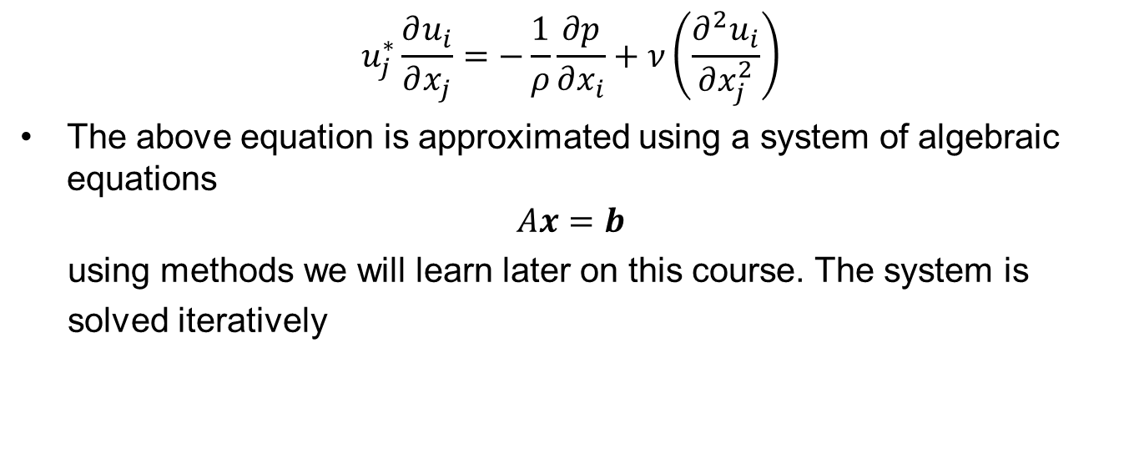
Iterative solution of NS
$$u_{j}^{∗}\frac{∂u_{i}}{∂x_{j}}=−\frac{1}{ρ}\frac{∂p}{∂x_{i}}+ν\left(\frac{∂^{2}u_{i}}{∂x_{j}^{2}}\right)$$
The above equation is approximated using a system of algebraic equations
$$Ax=b$$
using methods we will learn later on this course. The system is
solved iteratively

Slide 25
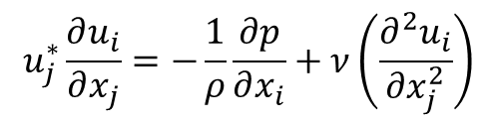
Iterations
$$u_{j}^{∗}\frac{∂u_{i}}{∂x_{j}}=−\frac{1}{ρ}\frac{∂p}{∂x_{i}}+ν\left(\frac{∂^{2}u_{i}}{∂x_{j}^{2}}\right)$$
k is iteration step
$$k=0$$
$$k=1$$
$$k=70$$
$$k=287$$

Slide 26
Development in time
$$t=0s$$
$$t=0.001s$$
$$t=0.03s$$
$$t=0.3s$$

Slide 27
NEXT TOPIC

Slide 28
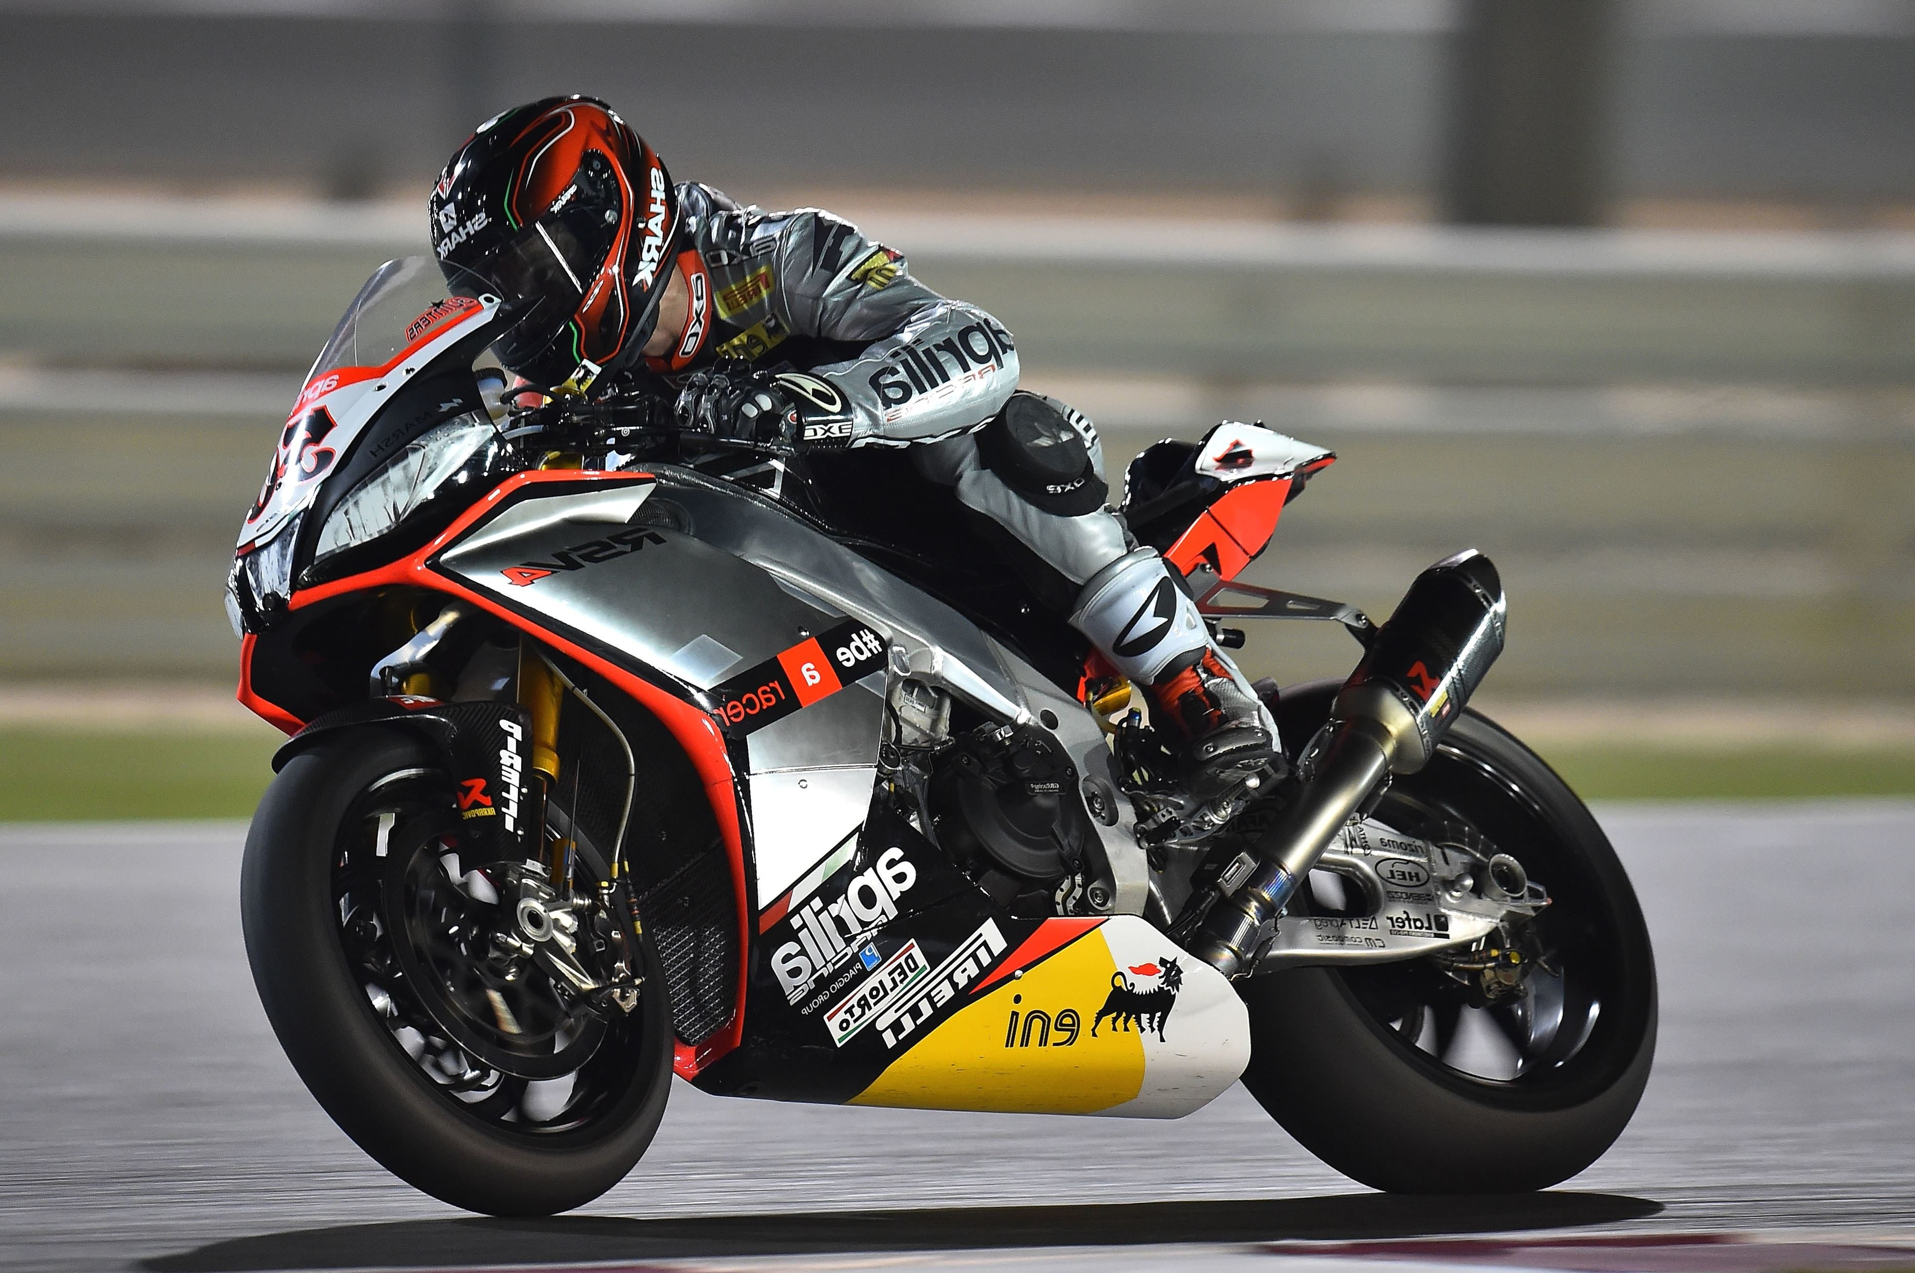
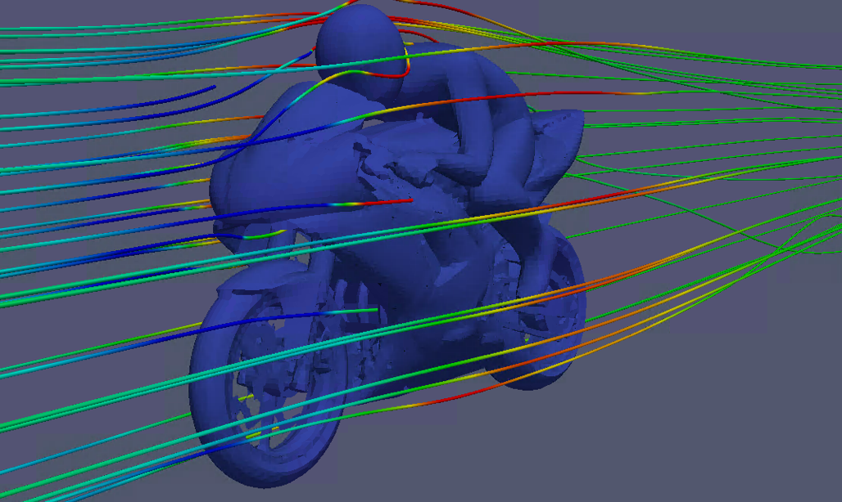
Steps of CFD solution

Slide 29
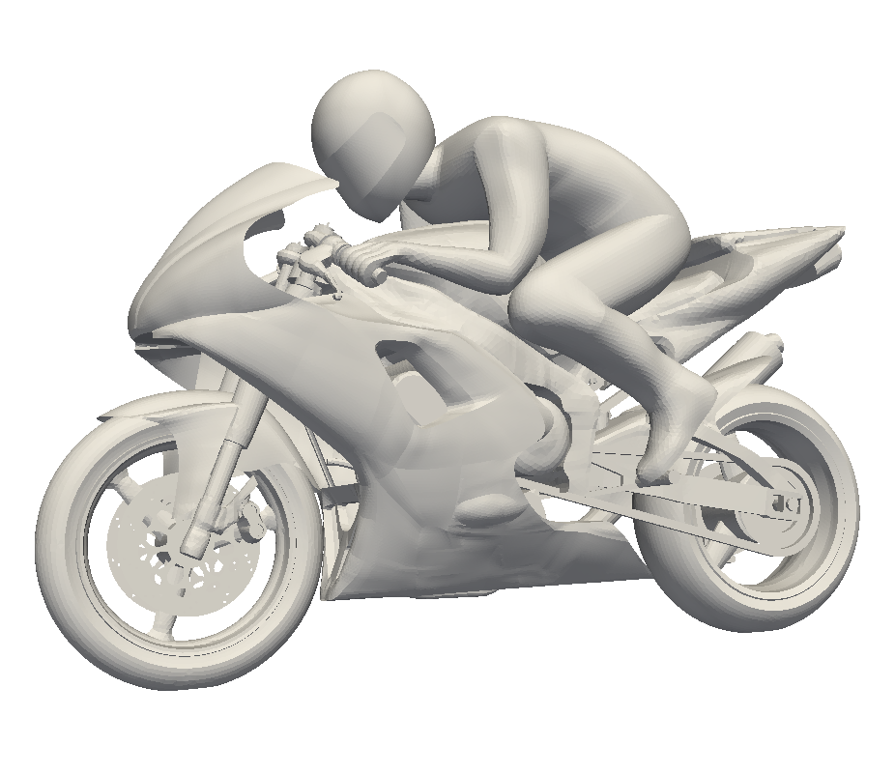
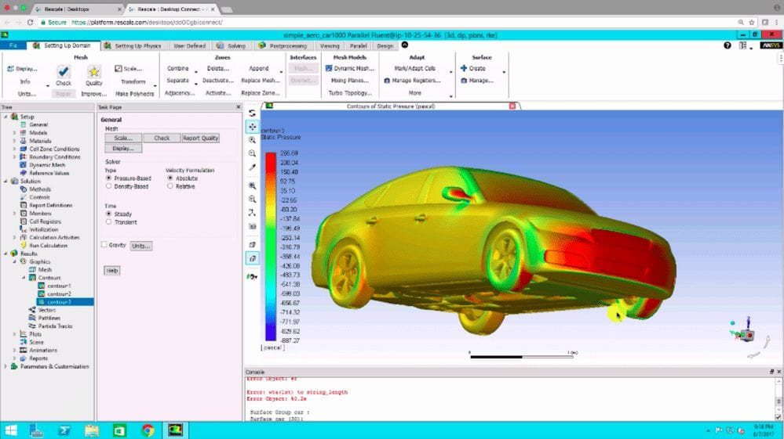
Steps of CFD solution
Preprocessing
Solver
Post processing

Slide 30
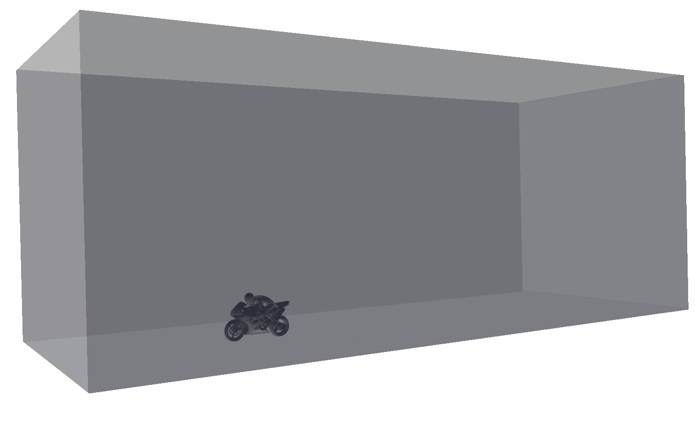
Preprocesing

Slide 31
Preprocessing
CAD
Geometry with suitable detail
Draw by yourself or prepare existing CAD for CFD
Meshing
Creating the mesh for CFD solution
Often the most time consuming part

Slide 32
Suitable level of detail

Slide 33
Domain
Atmosphere
Inlet
Outlet
Symmetry
Wall, ground

Slide 34
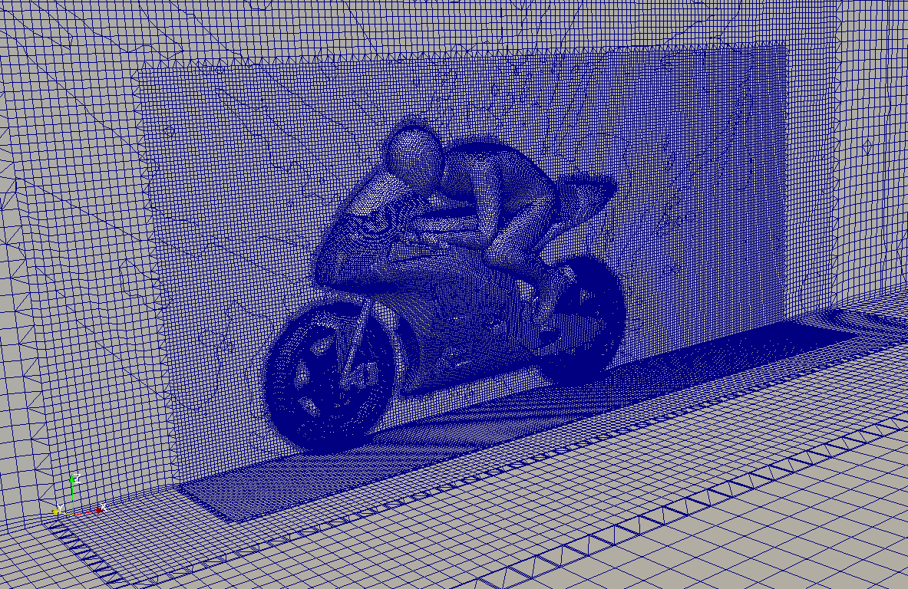
Meshing

Slide 35
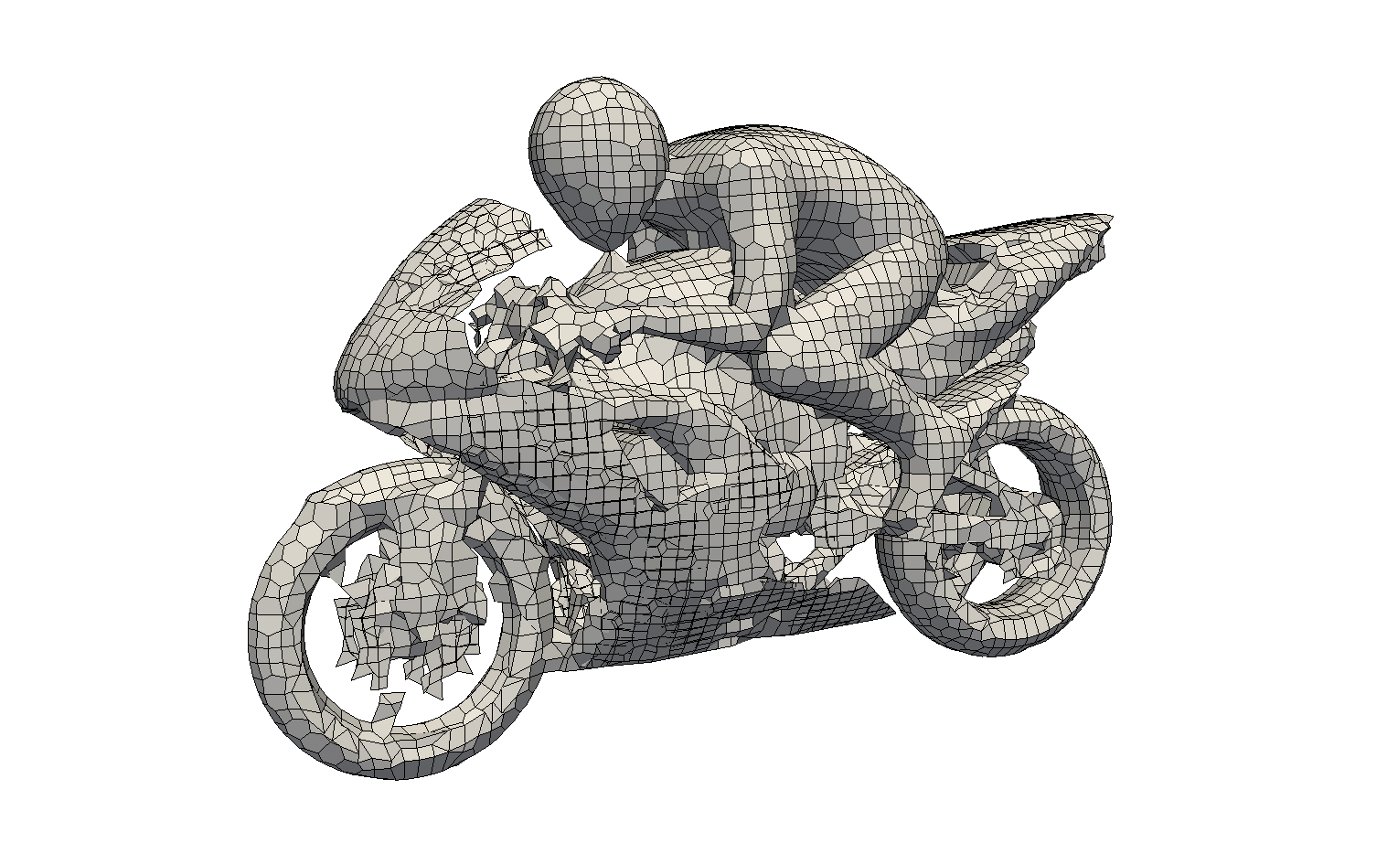
Surface details
Insufficient level of detail

Slide 36
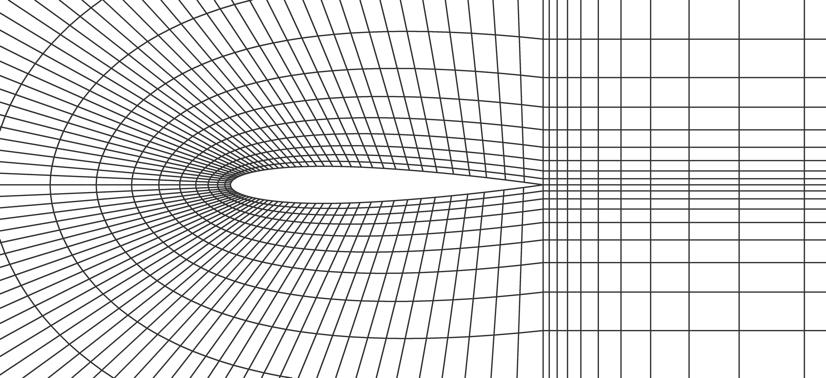
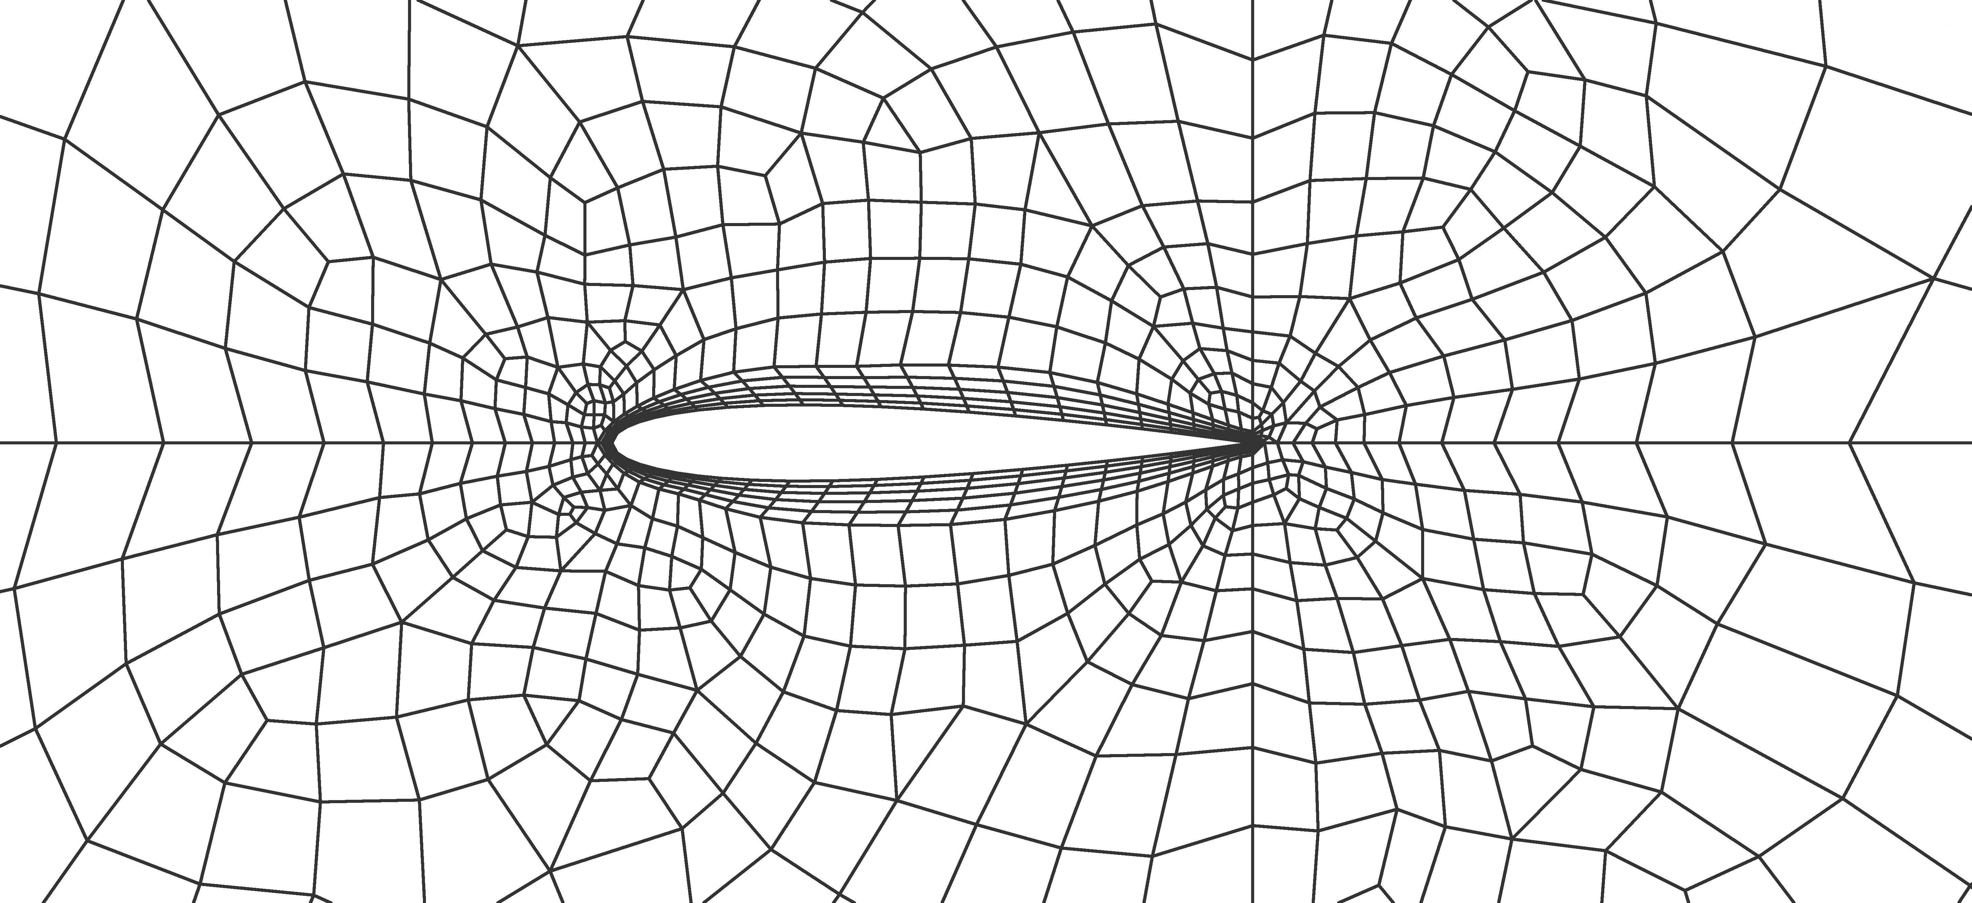
Mesh types
Structured mesh
Unstructured mesh

Slide 37
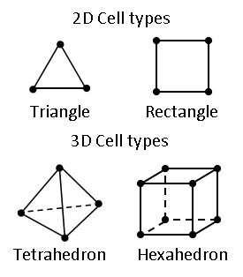
Cell types

Slide 38
Solver
Governing equations
Boundary conditions
Numerical methods
Turbulence model
Material properties
Saving of results

Slide 39
Post processing
Is the result reasonable?
Is the solution converged?
Is the solution grid independent?
How to present the results
Mean heat transfer coefficient vs. video

Slide 40
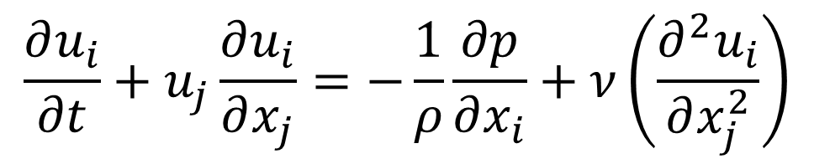
Time derivative term
$$\frac{∂u_{i}}{∂t}+u_{j}\frac{∂u_{i}}{∂x_{j}}=−\frac{1}{ρ}\frac{∂p}{∂x_{i}}+ν\left(\frac{∂^{2}u_{i}}{∂x_{j}^{2}}\right)$$

Slide 41
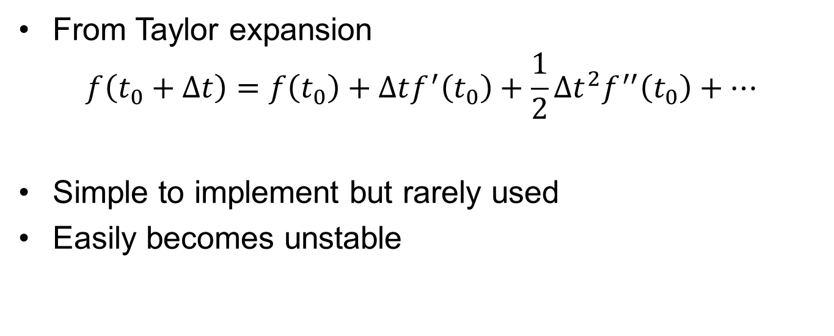
Explicit time stepping
From Taylor expansion
$$f\left(t_{0}+Δt\right)=f\left(t_{0}\right)+Δtf^{′}\left(t_{0}\right)+\frac{1}{2}Δt^{2}f^{′′}\left(t_{0}\right)+…$$
Simple to implement but rarely used
Easily becomes unstable
small
Explicit Euler

Slide 42

Implicit time stepping
The function values are taken “from the future”
$$f\left(t_{0}+Δt\right)=f\left(t_{0}\right)+Δtf^{′}\left(t_{0}+Δt\right)$$
Might require iteration because of $f^{′}\left(t_{0}+Δt\right)$
Commonly used in CFD
Stable and simple to implement but inaccurate
If possible, use Runge-Kutta. Rarely used in CFD.

Slide 43
Turbulence

Slide 44
More physics and chemistry

Slide 45

Algebraic equations
These are the most common equations we usually deal with (analytical solutions for specific problems in our course context)
The value of the variable we want to solve can be determined directly from a specific equation using for example a calculator
Some examples:
$$Δp=\frac{1}{2}ρV^{2}ξ\frac{L}{D}$$
$$Nu_{x}=0.332Re_{x}^{1/2}{Pr}^{1/3}$$

Slide 46

Linear system of equations
The solution for the system can be obtained with the inverse of matrix A:
$x=A^{−1}b$, where
$A^{−1}$ is the inverse of the coefficient matrix A

Slide 47

Advection and diffusion terms in PDEs
$$\frac{∂u}{∂t}+u\frac{∂u}{∂x}+v\frac{∂u}{∂y}+w\frac{∂u}{∂z}=−\frac{1}{ρ}\frac{∂p}{∂x}+ν\left(\frac{∂^{2}u}{∂x^{2}}+\frac{∂^{2}u}{∂y^{2}}+\frac{∂^{2}u}{∂z^{2}}\right)$$
$$\frac{∂T}{∂t}=α\left(\frac{∂^{2}T}{∂x^{2}}+\frac{∂^{2}T}{∂y^{2}}+\frac{∂^{2}T}{∂z^{2}}\right)$$
Momentum conservation of fluid in x-direction
Advection terms
Diffusion terms
Heat conduction in solids
Diffusion terms

Slide 48

Fluid flow equations
Navier-Stokes equations:
$$\frac{∂u}{∂t}+u\frac{∂u}{∂x}+v\frac{∂u}{∂y}+w\frac{∂u}{∂z}=−\frac{1}{ρ}\frac{∂p}{∂x}+ν\left(\frac{∂^{2}u}{∂x^{2}}+\frac{∂^{2}u}{∂y^{2}}+\frac{∂^{2}u}{∂z^{2}}\right)$$
$$\frac{∂v}{∂t}+u\frac{∂v}{∂x}+v\frac{∂v}{∂y}+w\frac{∂v}{∂z}=−\frac{1}{ρ}\frac{∂p}{∂y}+ν\left(\frac{∂^{2}v}{∂x^{2}}+\frac{∂^{2}v}{∂y^{2}}+\frac{∂^{2}v}{∂z^{2}}\right)$$
$$\frac{∂w}{∂t}+u\frac{∂w}{∂x}+v\frac{∂w}{∂y}+w\frac{∂w}{∂z}=−\frac{1}{ρ}\frac{∂p}{∂z}+ν\left(\frac{∂^{2}w}{∂x^{2}}+\frac{∂^{2}w}{∂y^{2}}+\frac{∂^{2}w}{∂z^{2}}\right)$$

Slide 49

Fluid flow equations
NS with tensor notation:
$$\frac{∂u_{i}}{∂t}+u_{j}\frac{∂u_{i}}{∂x_{j}}=−\frac{1}{ρ}\frac{∂p}{∂x_{i}}+ν\left(\frac{∂^{2}u_{i}}{∂x_{j}^{2}}\right)$$
NS in vector form:
$$\frac{∂V}{∂t}+V⋅∇V=−\frac{1}{ρ}∇p+ν∇^{2}V$$

